Slide 1

T O Y S A L E S A N A L Y S I S
GROUP MEMBERS:
Evans Ochieng’ Ojuok
Faith Njeri Mburu
Francis Mwangi Muthoni
Kellie Njoki Ndaru
Austin Alutsachi Murunga
GROUP MEMBERS:
Evans Ochieng’ Ojuok
Faith Njeri Mburu
Francis Mwangi Muthoni
Kellie Njoki Ndaru
Austin Alutsachi Murunga

Slide 2

Business Problem
Trends of toy sales over time
Performance of every product
Consumption of the products
Performance of contact persons
Products with most revenue
And any other insights

Slide 3

DATA UNDERSTANDING
Salesdata (Excel format)
Main Data – has sales information (22 columns and 2823 rows)
Product Master – product description
Data Dictionary – descriptions of the main data and product master

Slide 4

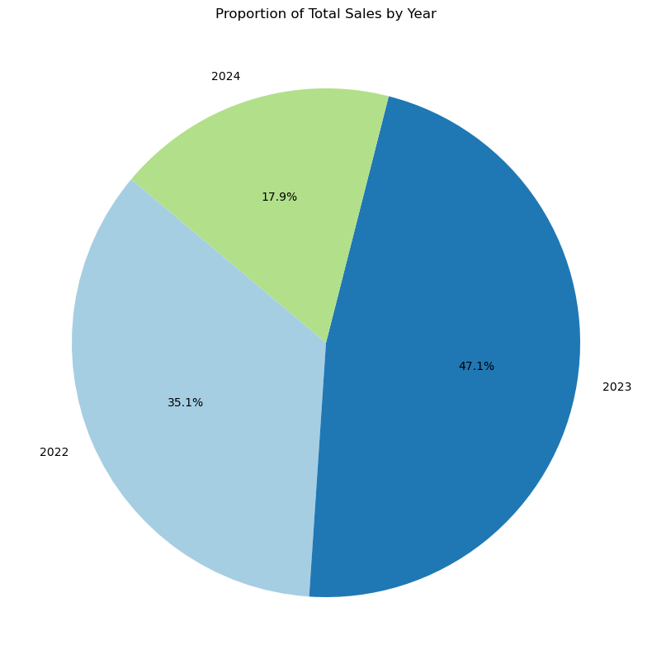

SALES OVER THE YEARS
Across the three years,the year 2023 had the highest sales of 47.1%.

Slide 5

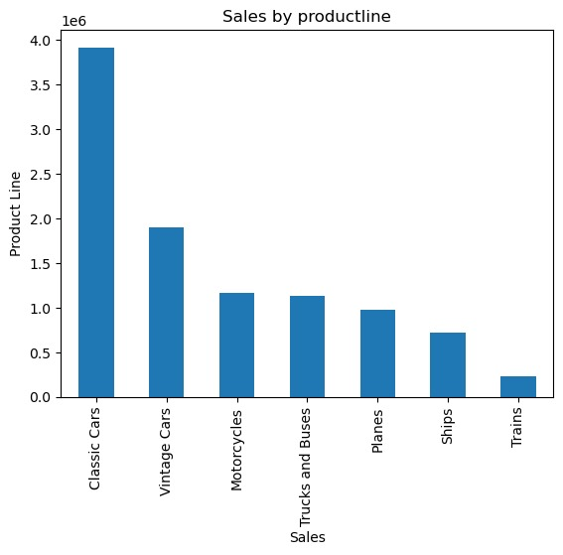
Sales of Every Product
With different toy products being sold, classic cars and vintage cars had the highest sales respectively.

Slide 6

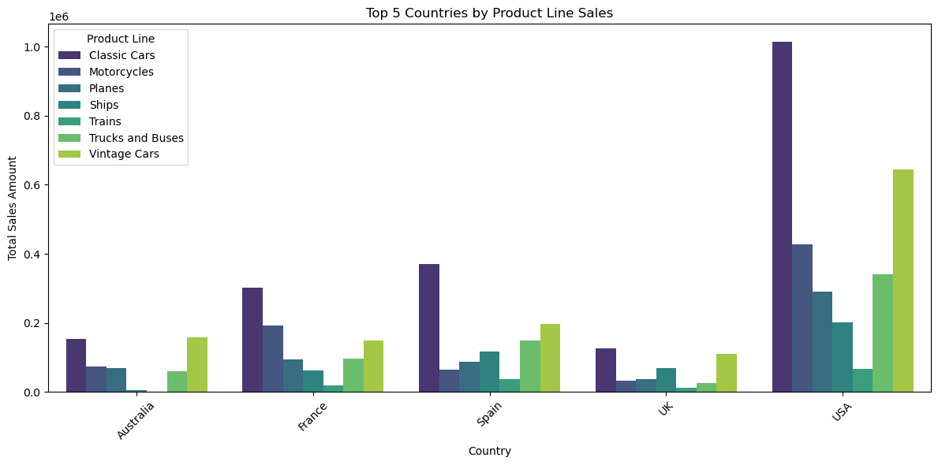


TOP COUNTRIES BY PRODUCT SALES
There is a common trend in every that cuts across all the countries in terms of product sales
Both classic cars and vintage cars respectively, have the highest sales in all countries

Slide 7
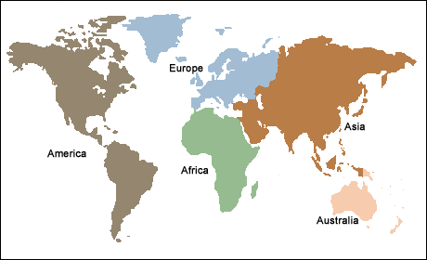
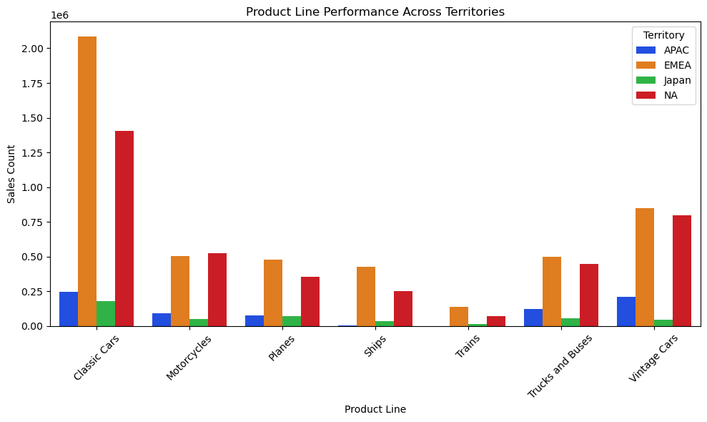
PRODUCT PERFOMANCE ACROSS TERRITORIES
Europe Middle East Africa (EMEA) is the territory with the highest sales of all products
North America (NA) also recorded high sales, the second territory after EMEA.
The Common trend of classic cars and vintage cars having the highest sales is still evident and it cuts across all territories

Slide 8

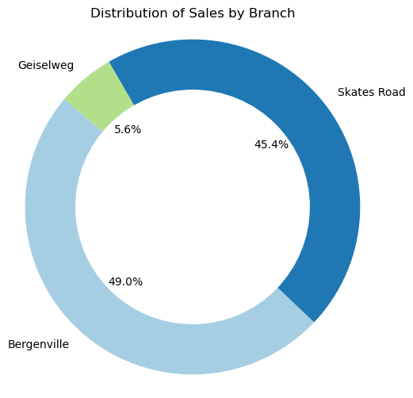
DISTRIBUTION OF SALES BY BRANCH
Bergenville is the branch with the highest sales of 49.0%
Skates Road branch also recorded high sales.This branch had 45.9%
Geiselweg branch had the lowest sales of 5.6%

Slide 9

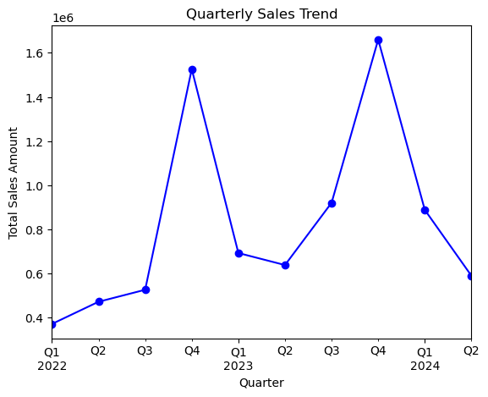

QUARTERLY SALES TRENDS
The quarterly sales trends show the trends in different quarters across the years.
From the line graph, the fourth quarter records the highest number of sales for the year 2022 and 2023

Slide 10

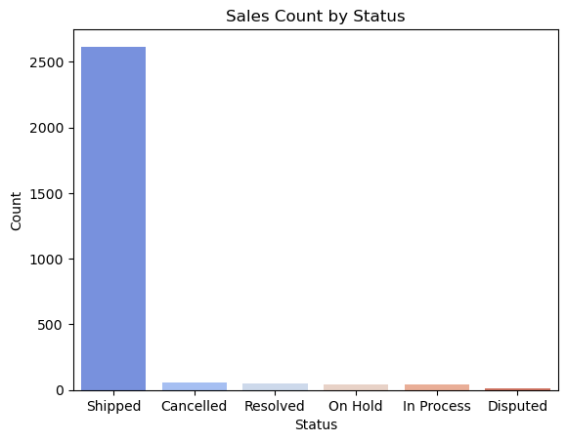

SALES COUNT BY STATUS
The bar graph shows the shopping status count.
Most of the products were successfully shipped without any hindrance.

Slide 11

THANK YOU
ANY QUESTIONS ?

